Slide 1
BANK LOAN CASE STUDY
Data Analysis Project

Slide 2
PROJECT DESCRIPTION
The main aim of this project is to identify patterns that indicate if a customer will have difficulty paying their installments. This information can be used to make decisions such as denying the loan, reducing the amount of loan, or lending at a higher interest rate to risky applicants. The company wants to understand the key factors behind loan default so it can make better decisions about loan approval.
The dataset contains information about loan applications. It includes two types of scenarios:
Customers with payment difficulties: These are customers who had a late payment of more than X days on at least one of the first Y installments of the loan.
All other cases: These are cases where the payment was made on time.

Slide 3
TECH STACK
In this project, Microsoft Excel 2019 is used to perform EDA and other analysis.
LINK: https://docs.google.com/spreadsheets/d/1aCkrCOfKZIhX-_VlS01b3igf6WhbwHuI/edit?usp=sharing&ouid=111360395057791388166&rtpof=true&sd=true
Main dataset : application_data
Reference dataset: previous_application_data
Column Information : columns_description

Slide 4
APPROACH
Firstly, glanced over the dataset-application_data and understood the columns by using the additional columns_description file.
Data Pre-processing: Handling null values, outliers and feature selection.
Data Analysis: Deriving insights and patterns from the analysis process.
Data Visualization: Plotting appropriate graphs in order to represent the analysis.
Conclusion: Drawing key insights and possible suggestions

Slide 5
DATA ANALYSIS PROCESS
Data Cleaning
Examined the dataset and the column description file. Tried to understand the significance of different variables and dropped the unnecessary columns such as : OWN_CAR_AGE,APARTMENTS_AVG,etc. (Marked RED in the columns description file)
Counted the null values in each column using =COUNTIF(column_range,””)
Calculated the null value percentage for each column and plotted column graph. (<50%)
Dropped 3 rows of some columns which had a few nulls.
Handled the null values by imputing median and mode, since many columns had outliers.

Slide 6
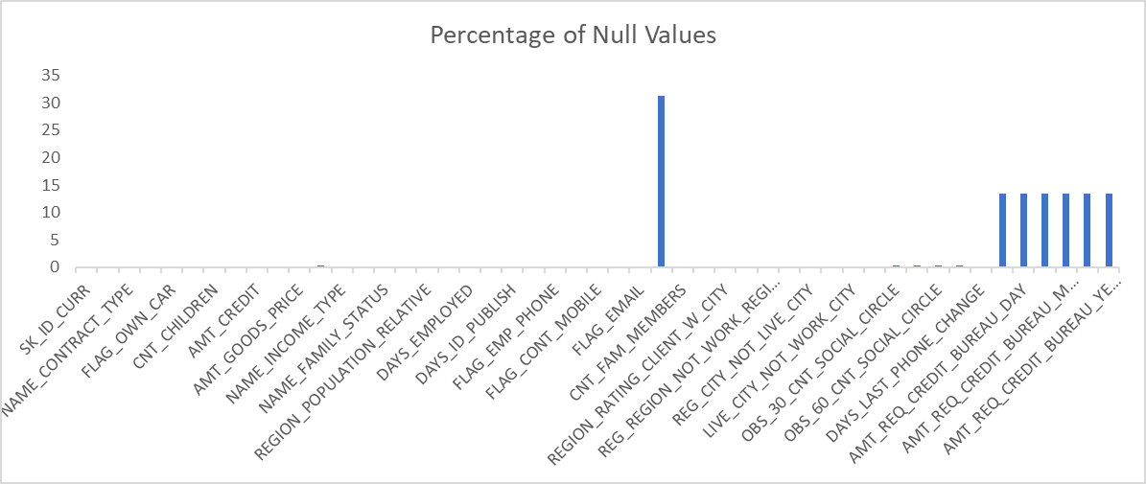
Occupation type has highest number of null values: 31.308%

Slide 7
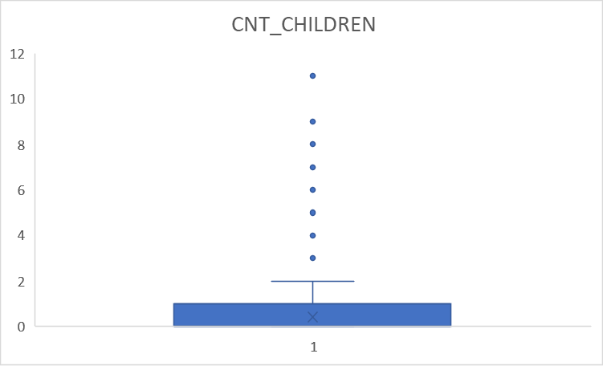
OUTLIER DETECTION
Possible Outlier: 11
Conditional Formatting Formula: OR(A1<lowerbound, A1>upperbound)

Slide 8
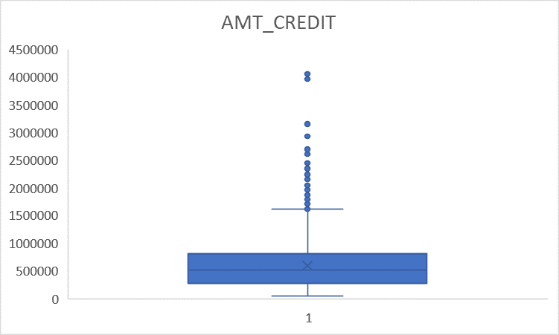
Possible Outlier: 4050000 ~40L

Slide 9
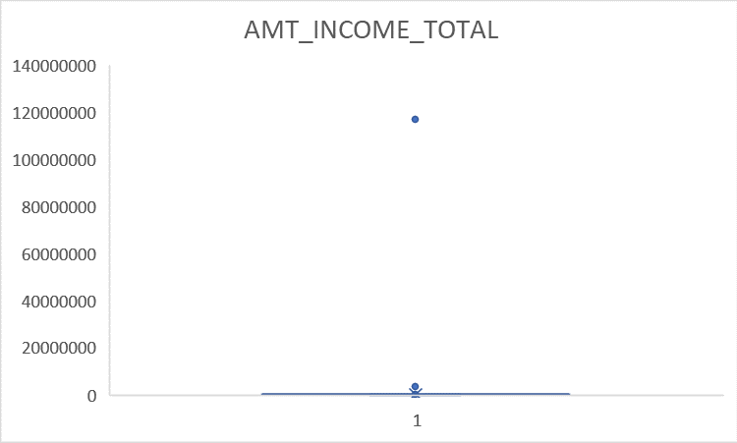
Possible outliers such as : 117000000 ~ 11 Crores

Slide 10
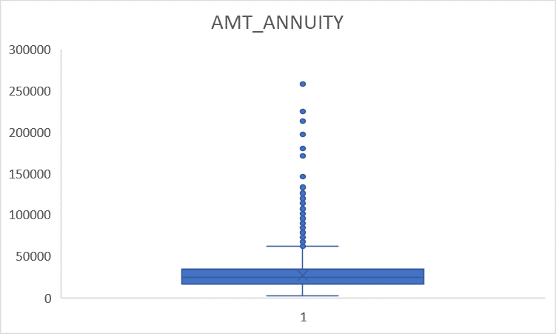
Possible Outlier: 258025.5 ~ 2.5L

Slide 11
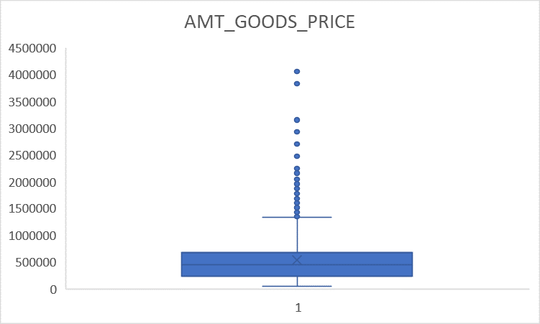
Possible Outlier: 4050000 ~ 40L

Slide 12
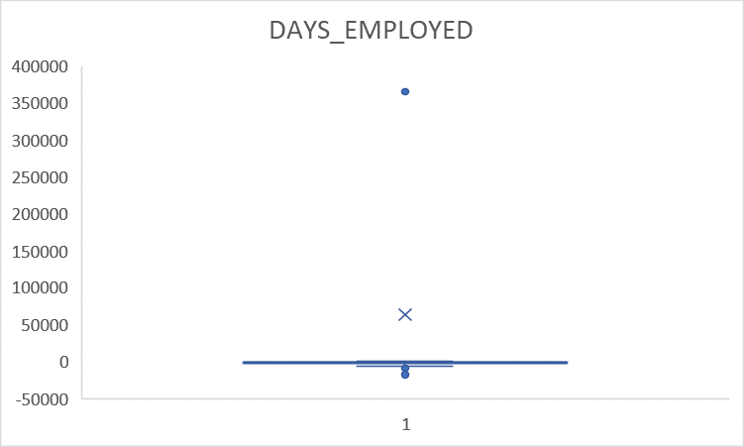
Outliers such as : 365243 days ~ 1000 years

Slide 13
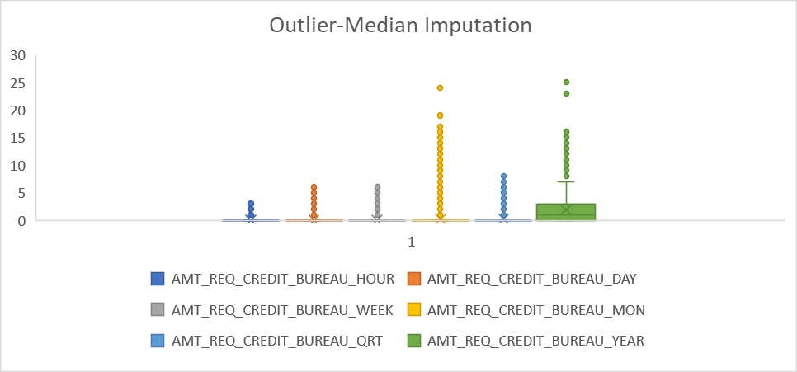
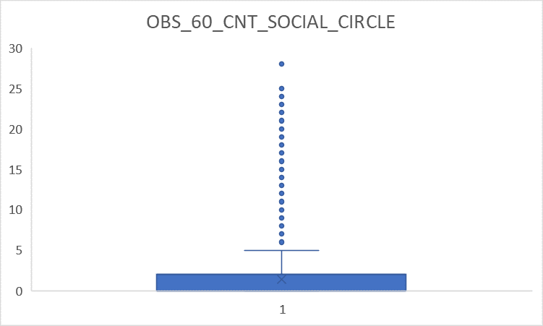
MEDIAN/MODE IMPUTATION

Slide 14
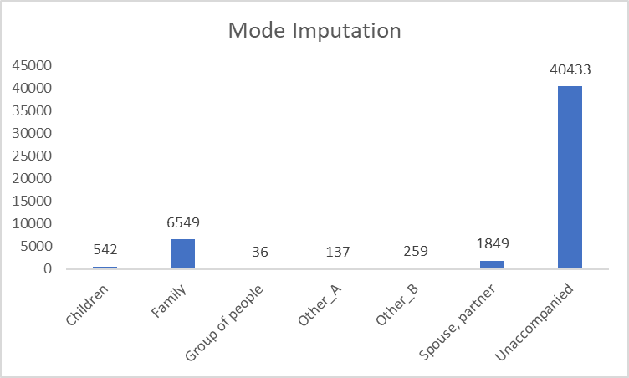
NAME_TYPE_SUITE

Slide 15
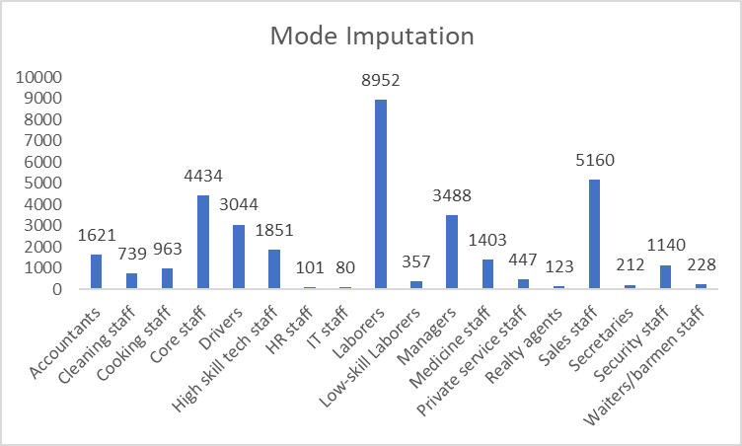
OCCUPATION_TYPE

Slide 16
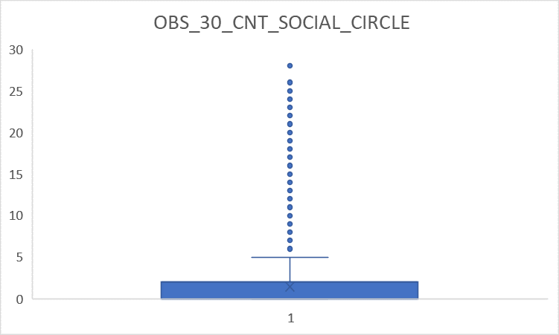
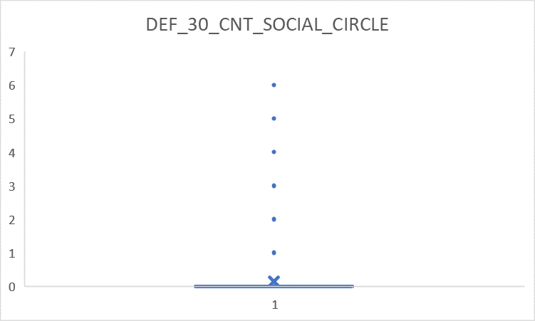
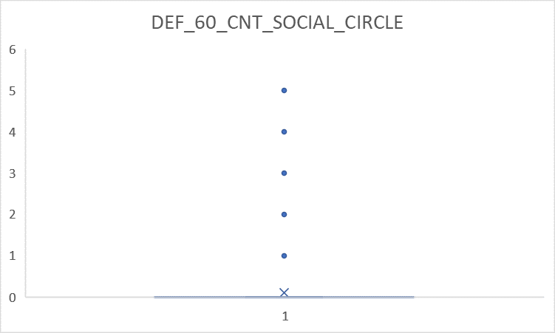
Median Imputation as many outliers exist.

Slide 17
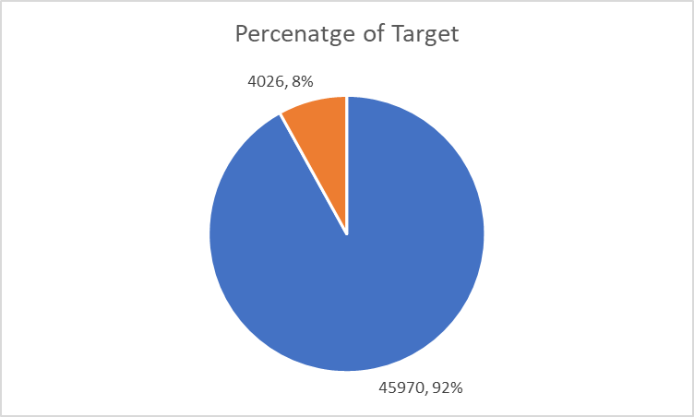
Data Imbalance
92% of customers are re-payers of loan and just 8% customers are defaulters.
Hence, the data is imbalanced as shown in the graph.

Slide 18
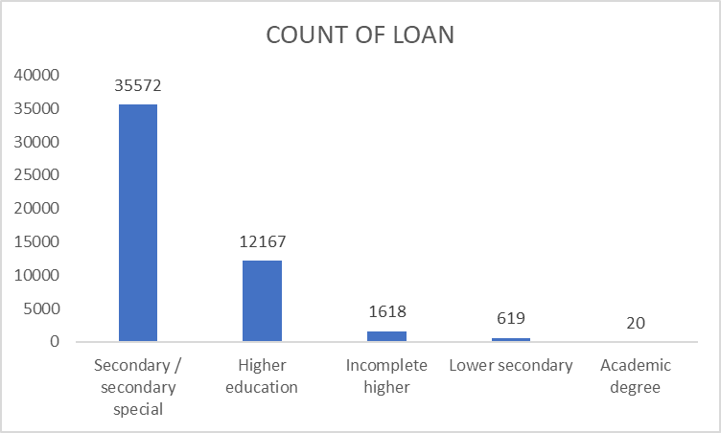
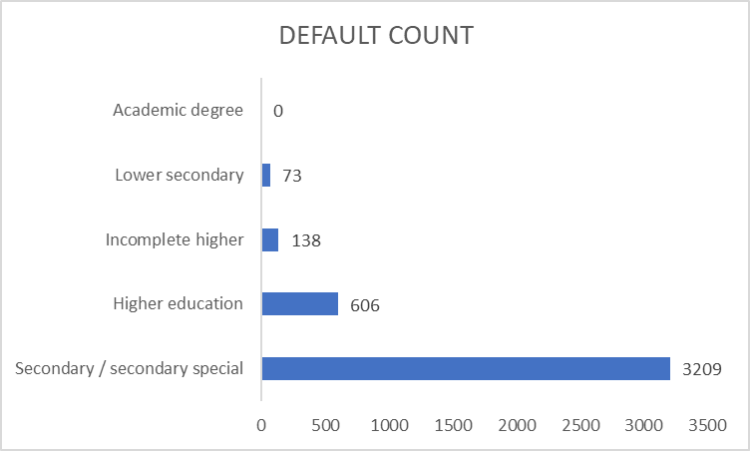
UNIVARIATE AND SEGMENTED UNIVARIATE ANALYSIS
EDUCATION
Highest default percent of 79.7% and Lowest default percent of 0%

Slide 19
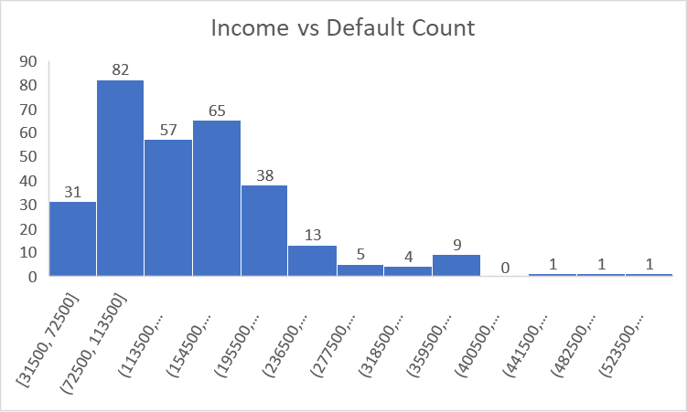
TOTAL INCOME

Slide 20
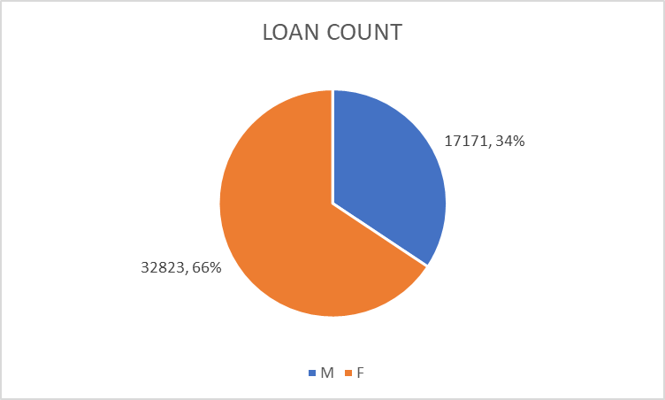
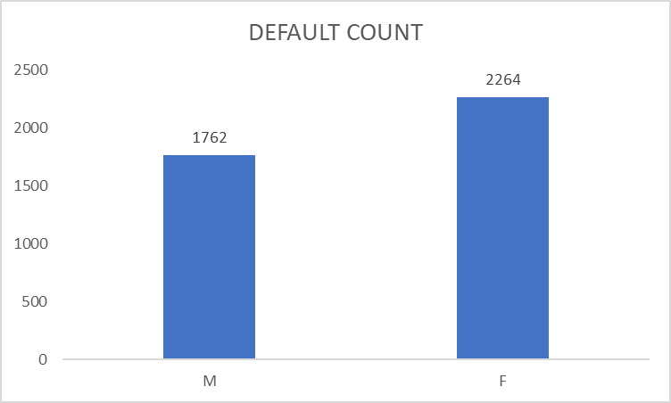
GENDER Female-Highest default rate of 56% Male - 43%

Slide 21
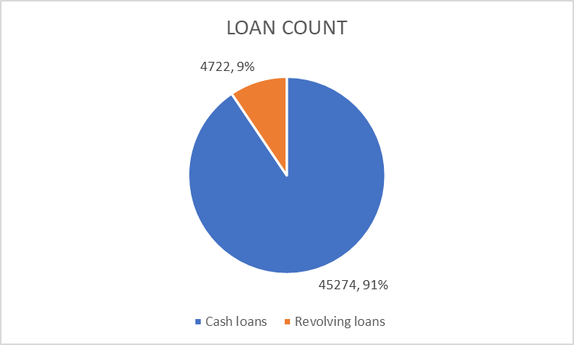
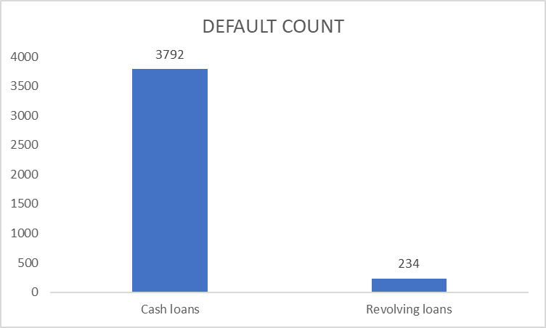
LOAN TYPE Highest default rate on Cash loans (94%)

Slide 22
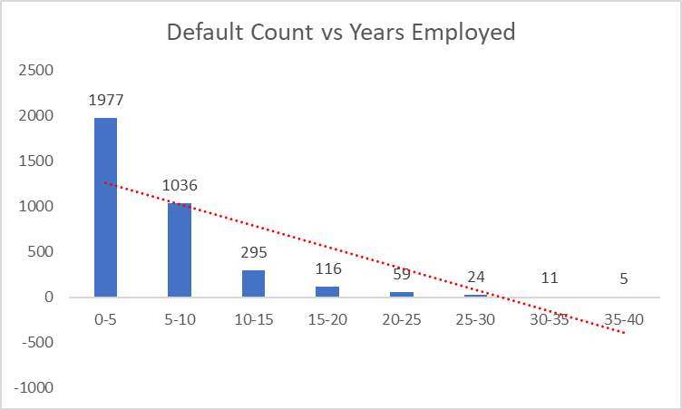
DAYS EMPLOYED As employment years increase, default rate decreases.

Slide 23
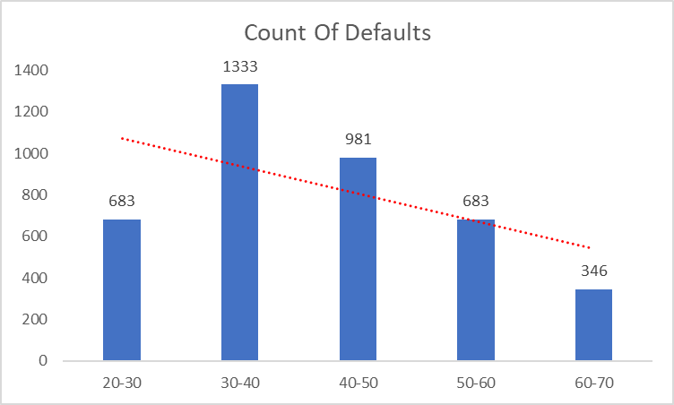
AGE As the age increases, default rate decreases.

Slide 24
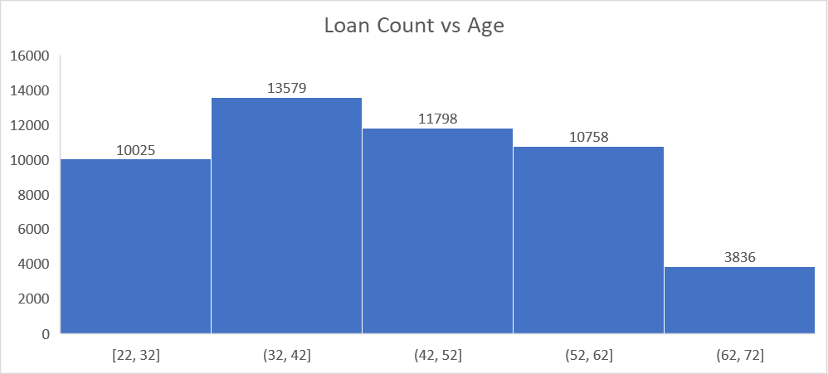
32-42 age range apply for maximum number of loans

Slide 25
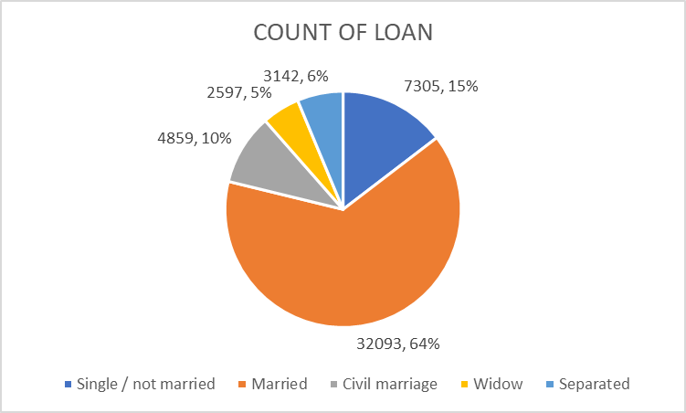
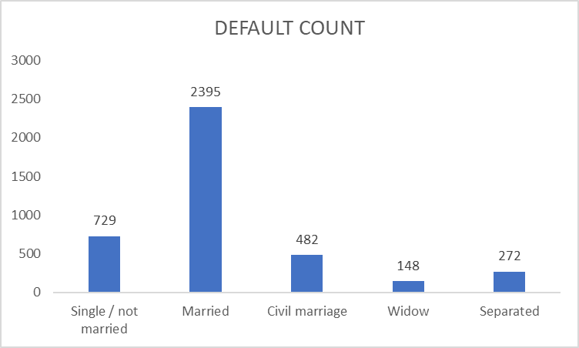
FAMILY TYPE Married customers have highest default rate of 59.4%

Slide 26
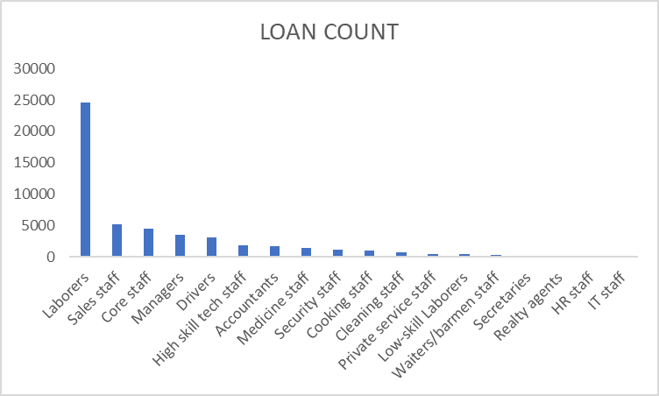
OCCUPATION TYPE

Slide 27
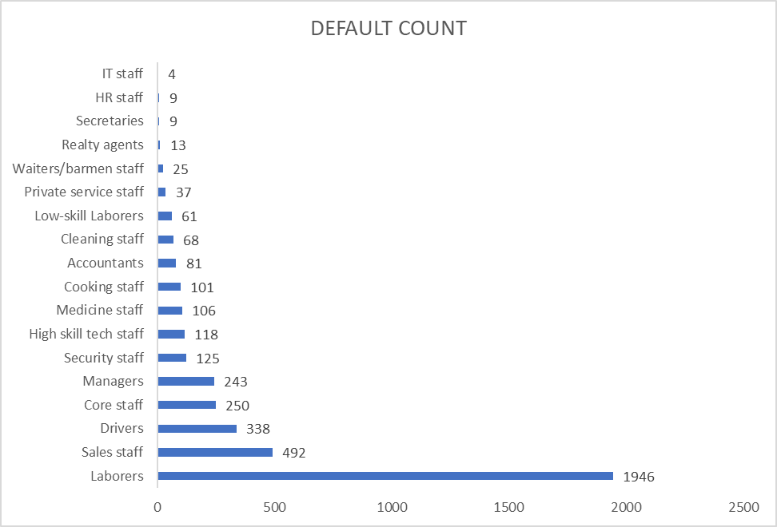
Labour class has the highest default rate of 48%

Slide 28
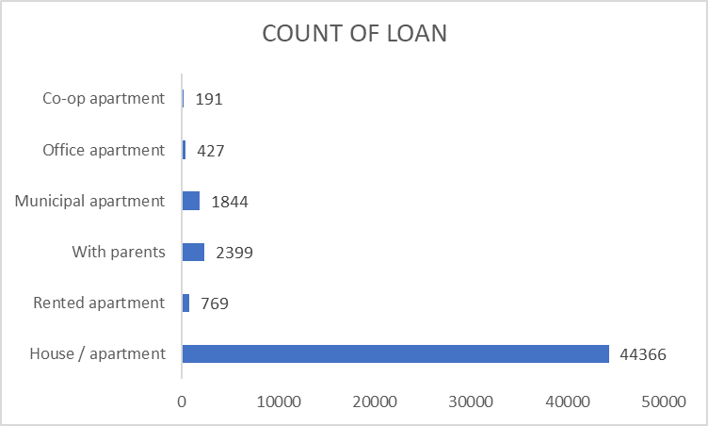
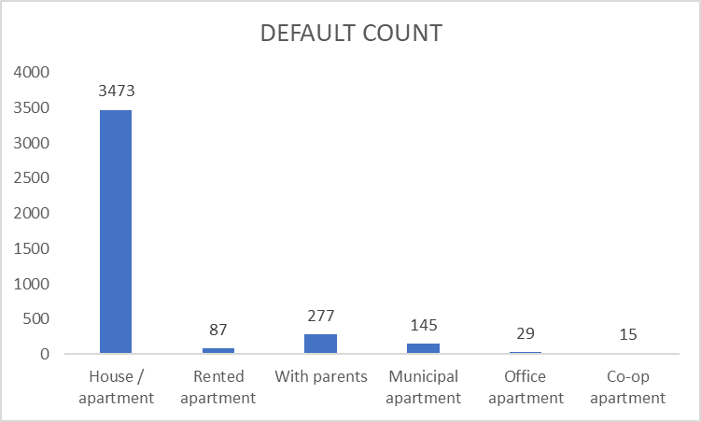
HOUSING TYPE Customers who lived in home/apartment have highest default rate of 86%

Slide 29
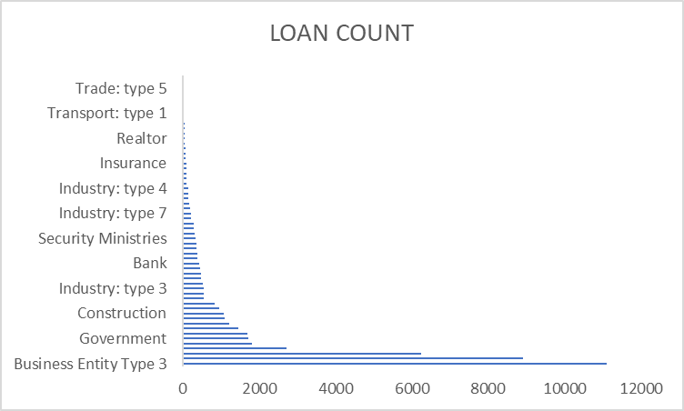
ORGANIZATION TYPE

Slide 30
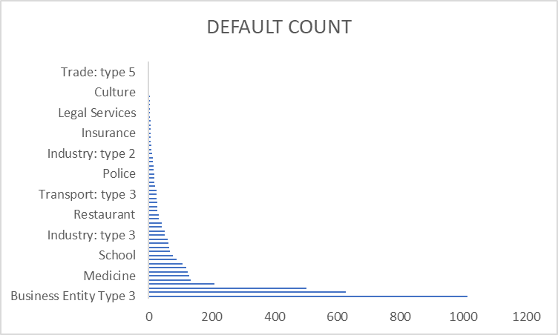
Business Entity Type 3 have highest default rate of 25%

Slide 31
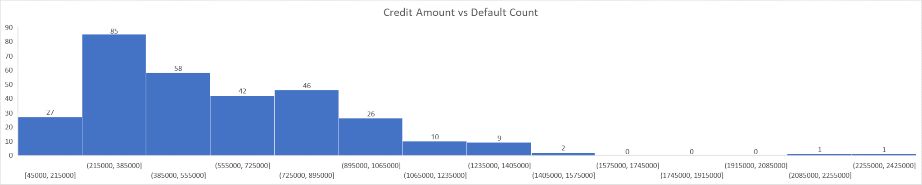
CREDIT AMOUNT
Credit amount of 215000-385000 : Highest default

Slide 32
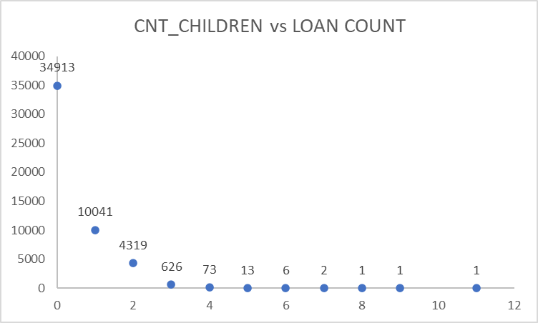
CHILDREN

Slide 33
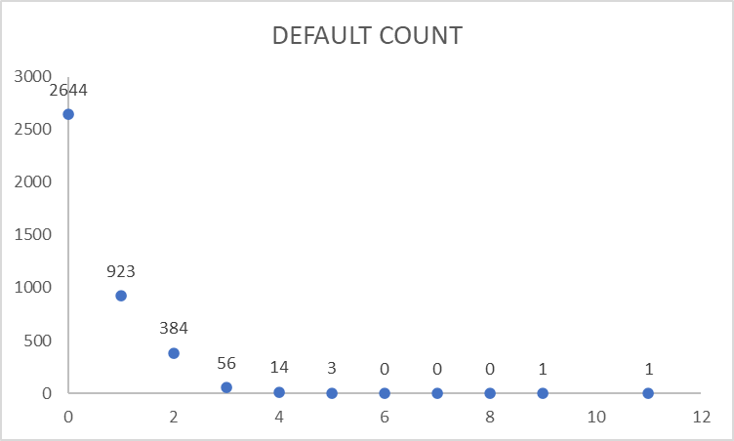
Customers with no children have defaulted the most : 65%

Slide 34
CORRELATION ANALYSIS
Correlation between the following variables and have been filtered for defaulters:
AMT_CREDIT & AMT_GOODS_PRICE : 0.982267963
AMT_CREDIT & AMT_ANNUITY: 0.749665201
AMT_CREDIT & AMT_INCOME_TOTAL : 0.015271444
AGE & AMT_CREDIT : 0.142642738
YEARS_EMPLOYED & AMT_CREDIT : 0.018801035

Slide 35
KEY INSIGHTS
Customers with high qualifications tend to default less as compared to those with lower secondary or secondary education.
As the income of a customer increases, the chances of default decreases. Hence, the banks should consider the income of the customers while giving out loan approvals.
Female customers tend to default more as compared to male clients.
Customers with cash loans have defaulted more as compared to revolving loans.
As the age and employment years increase, chances of default decrease. Hence, such customers can be made a priority while offering loans.
Married customers have higher tendency to default.
Labour class has the highest default rate and IT Staff has the lowest. So, the customers who work in the IT industry can be potential non-risky customers for the bank.
Customers living in the home/apartment have high default rate.
Business Entity Type 3 have highest default rate. So, the banks can ask for more collateral proofs from them.
Customers with no children tend to default more as compared to those who have children.

Slide 36
THANK YOU!

